Slide 1
Aliens?

Slide 2
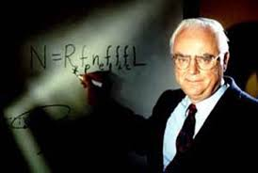
Is There Intelligent Life Out There?
The Drake Equation
Number of Civilizations=N_{HP} x f_{life} x f_{civ} x f_{now}
N_{HP} = the number of hospitable planets
f_{life} = the fraction of hospitable planets that actually have live
f_{civ} = the fraction of life-bearing planets upon which a civilization capable of interstellar communication has at some time arisen
f_{now} = the fraction of civilization-bearing planets that have a civilization now
Notes:
Drake equation for just the Milky Way

Slide 3
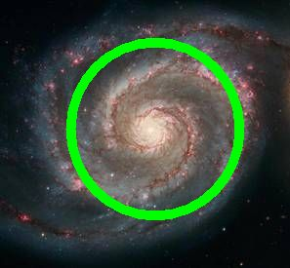
The Rare Earth Hypothesis
The conditions that make life on Earth possible are so rare that life likely does not exist elsewhere.
There’s a relatively thin galactic habitable zone

Slide 4
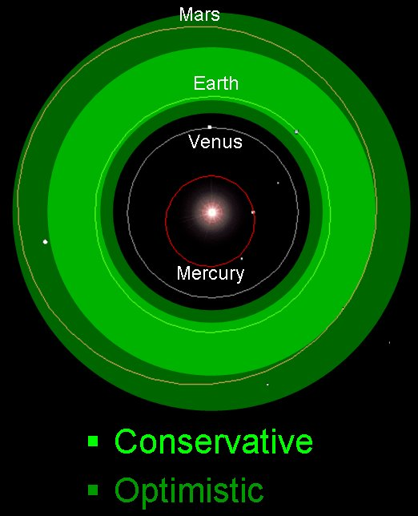
The Rare Earth Hypothesis
2. There’s a relatively thin solar system habitable zone

Slide 5
The Rare Earth Hypothesis
3. The protection of Jupiter
Jupiter’s gravity redirects comets away from Earth
4. Climate stability
Just the right mix of gasses in the atmosphere
Gasses are cycled
Example: Carbon dioxide would not cycle without plate tectonics
The Earth’s large moon keeps the Earth’s tilt stable
Notes:
If tilt changed, seasons would be more severe

Slide 6
The Rare Earth Hypothesis
What else makes intelligent life on Earth possible?
Characteristics of the Sun
Size of the Earth
Distance of the Earth to Sun

Slide 7
Even if other planets do exist that have all the right conditions for life, does that mean that life (or especially intelligent life) will develop?

