Slide 1
Classical Greece

Slide 2
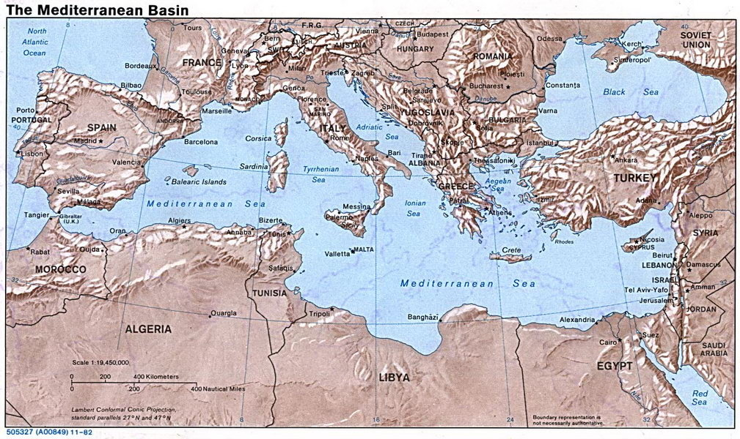
5.1: Early Greece
Two cultures: Minoan and Mycenaeans
Minoans
Developed in Crete
Society based on sailing, trade, fishing

Slide 3
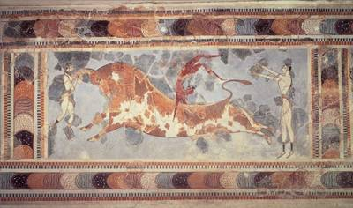

Slide 4
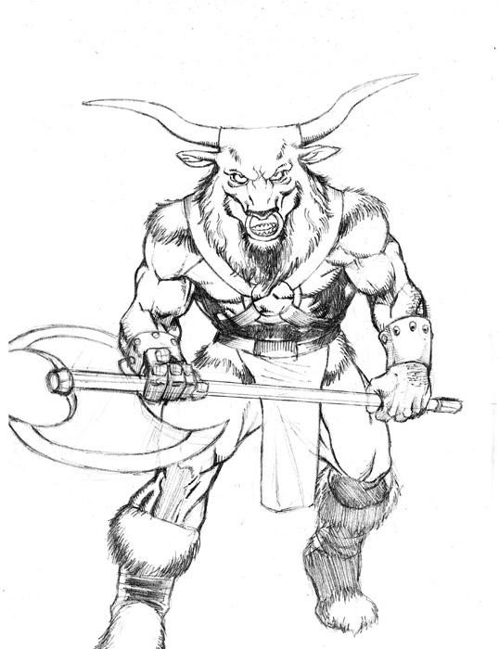
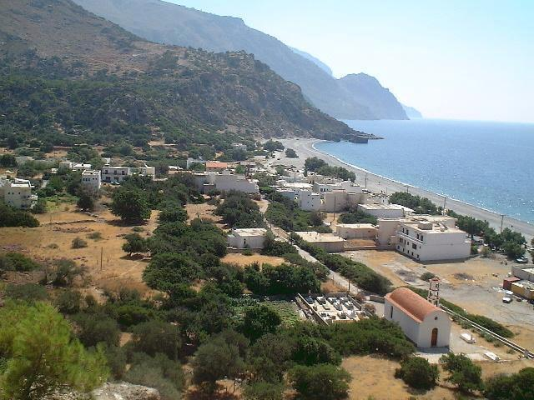
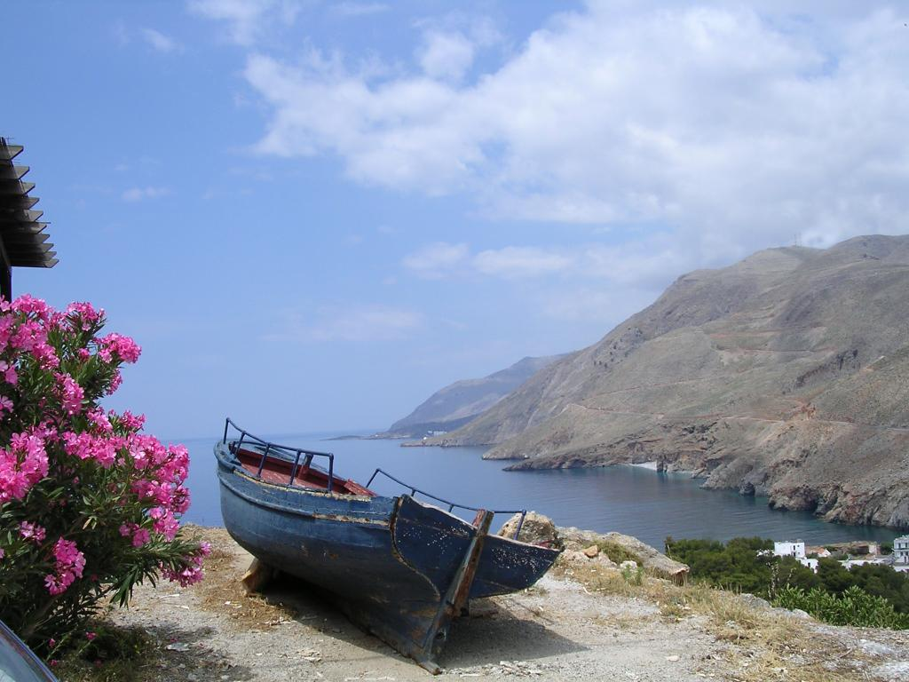

Slide 5
Mycenaean States
Conquered the Minoans
Considered the first Greeks
Powerful, violent societies
By 1100 B.C. most Mycenaean states in ruins
In 800’s B.C., city-states emerge
Each polis developed independently of its neighbors
Own customs, government, etc.

Slide 6
Sparta
Culture based on military strength
Agricultural and other work done by slaves; Spartans focused on training to become elite warriors
At age 7 entered school to train for combat
After training boys sent to wilderness to survive
At age 20 became soldiers for 10 years
Women trained physically to bear strong children
Video clip

Slide 7
Greek mythology
Hundreds of gods
12 most important ones lived on Mount Olympus
Not perfect; flawed and unpredictable
Stories of the exploits of heroes
Read p.133

Slide 8
5.2 The Classical Age
Development of Athenian Democracy
Previously, large gaps in wealth and power led to conflict
In 590’s BC, Solon changes laws so all men can take part in assembly and serve on juries
Cleisthenes establishes democracy
Nature of Athenian Democracy
Free male Athenians, over 20 years old who had completed military training could participate
Required to vote, serve in office if elected, serve on juries, fight during war
Direct democracy: all eligible voters made laws and important decisions

Slide 9
The Persian Wars
Video clip

Slide 10
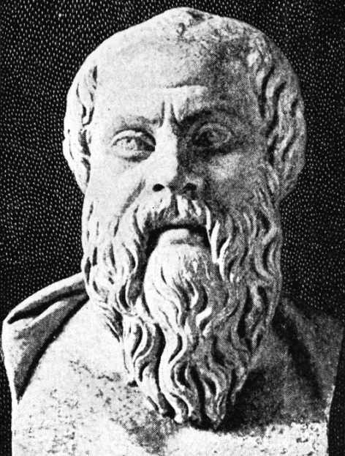
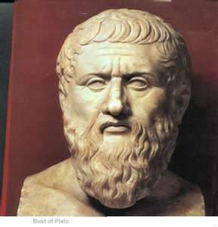
Greek Philosophy
Socrates
Truth, justice, virtue
Taught by asking questions
“What is truth?”
Plato
Nature of truth and goodness
Ideal form of government
Did not support democracy-philosophers should be kings
Founded the Academy-place for philosophers to teach and hold debates

Slide 11
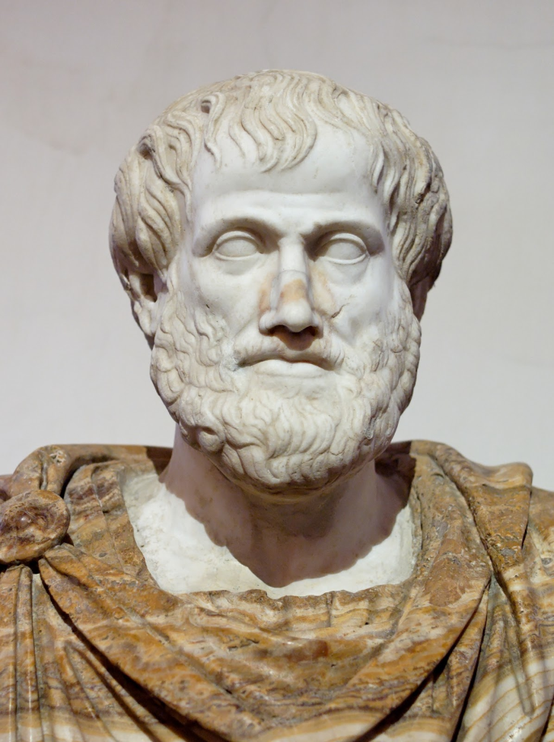
Philosophy cont.
Aristotle
Emphasized logic and reason
Reason: clear and ordered thinking
Learn from observation
Logic: the process of making inferences
Birds have feathers and lay eggs
Owl have feathers and lay eggs
Therefore, an owl must be a type of bird

Slide 12
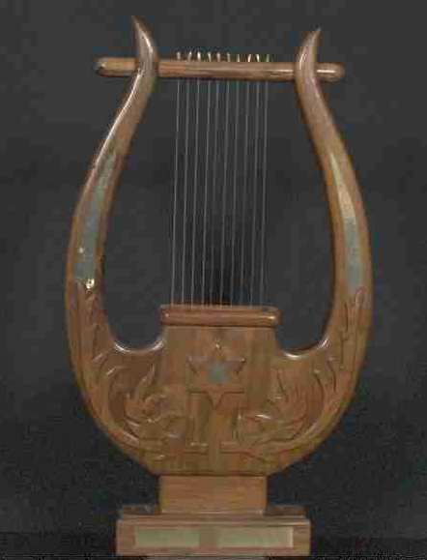
Greek Literature
Epics
Long poems that tell stories of great events and heroes
Homer’s Iliad and Odyssey most famous
Lyric poetry
Deal with emotions and desires
Accompanied by lyre
History
Drama
Comedies
Satire

Slide 13
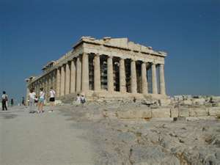
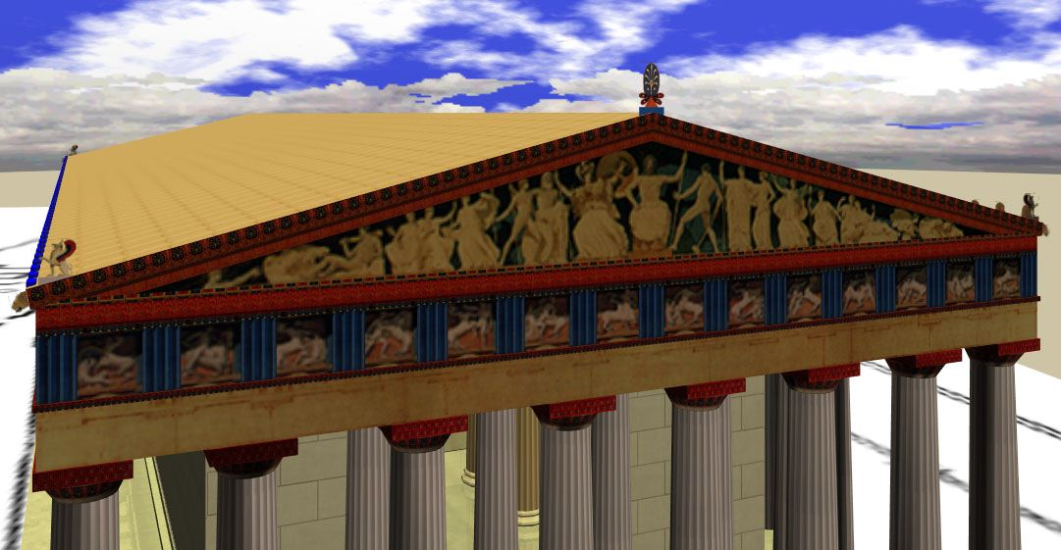
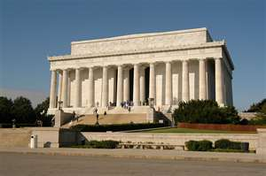
Greek Architecture

Slide 14
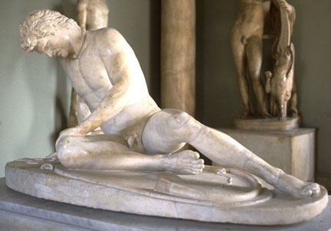
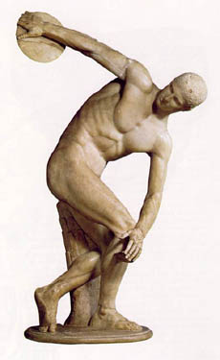
Greek Sculpture

Slide 15
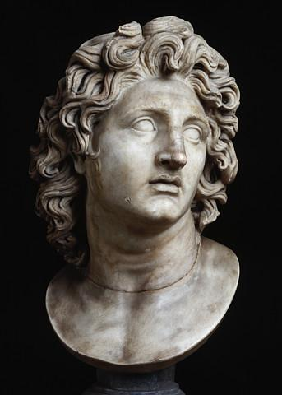
5.4 Alexander the Great
The Rise of Macedonia
Kingdom in Northern Greece
Conquered all major city-states in Greece except Sparta under Philip II
Alexander takes over
Philip assassinated 336 B.C.; son Alexander takes throne
Brutally suppresses rebellion in Thebes

Slide 16
Alexander cont.
Conquered the Persian empire
Advanced to India
Died at age 33 on way back from India
Read “Two Sources on Alexander,” p. 152
Video clip

Slide 17
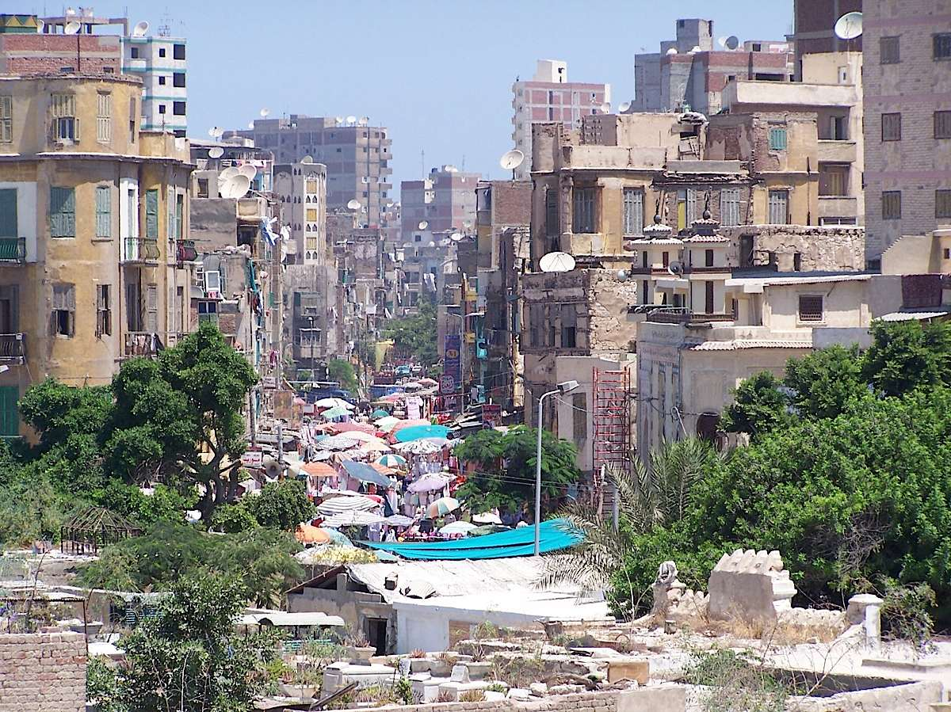
The Hellenistic World
Alexander’s empire blends Greek, Persian, Egyptian, and other cultures
Marries Persian princesses and encourages other Greeks to do the same
Builds cities that become centers of learning and trade
Alexandria, Egypt most famous example

