Slide 1
North America Before the Europeans

Slide 2
Guess the City!
As the sun rose over the rich floodplain, the people of the riverbank city set about their daily tasks. Some went to shops where they manufactured goods, crafted pottery, worked metal, or fashioned ornamental jewelry-goods designed to be exchanged in the far corners of the continent. Others left their densely populated neighborhoods for the outlying countryside, where in the summer heat they worked the seemingly endless fields that fed the city. From almost any point people could see the great temple that rose from the center of their city-the temple where priests in splendid costumes acted out public rituals of death and renewal.
-Faragher, et al. Out of Many

Slide 3
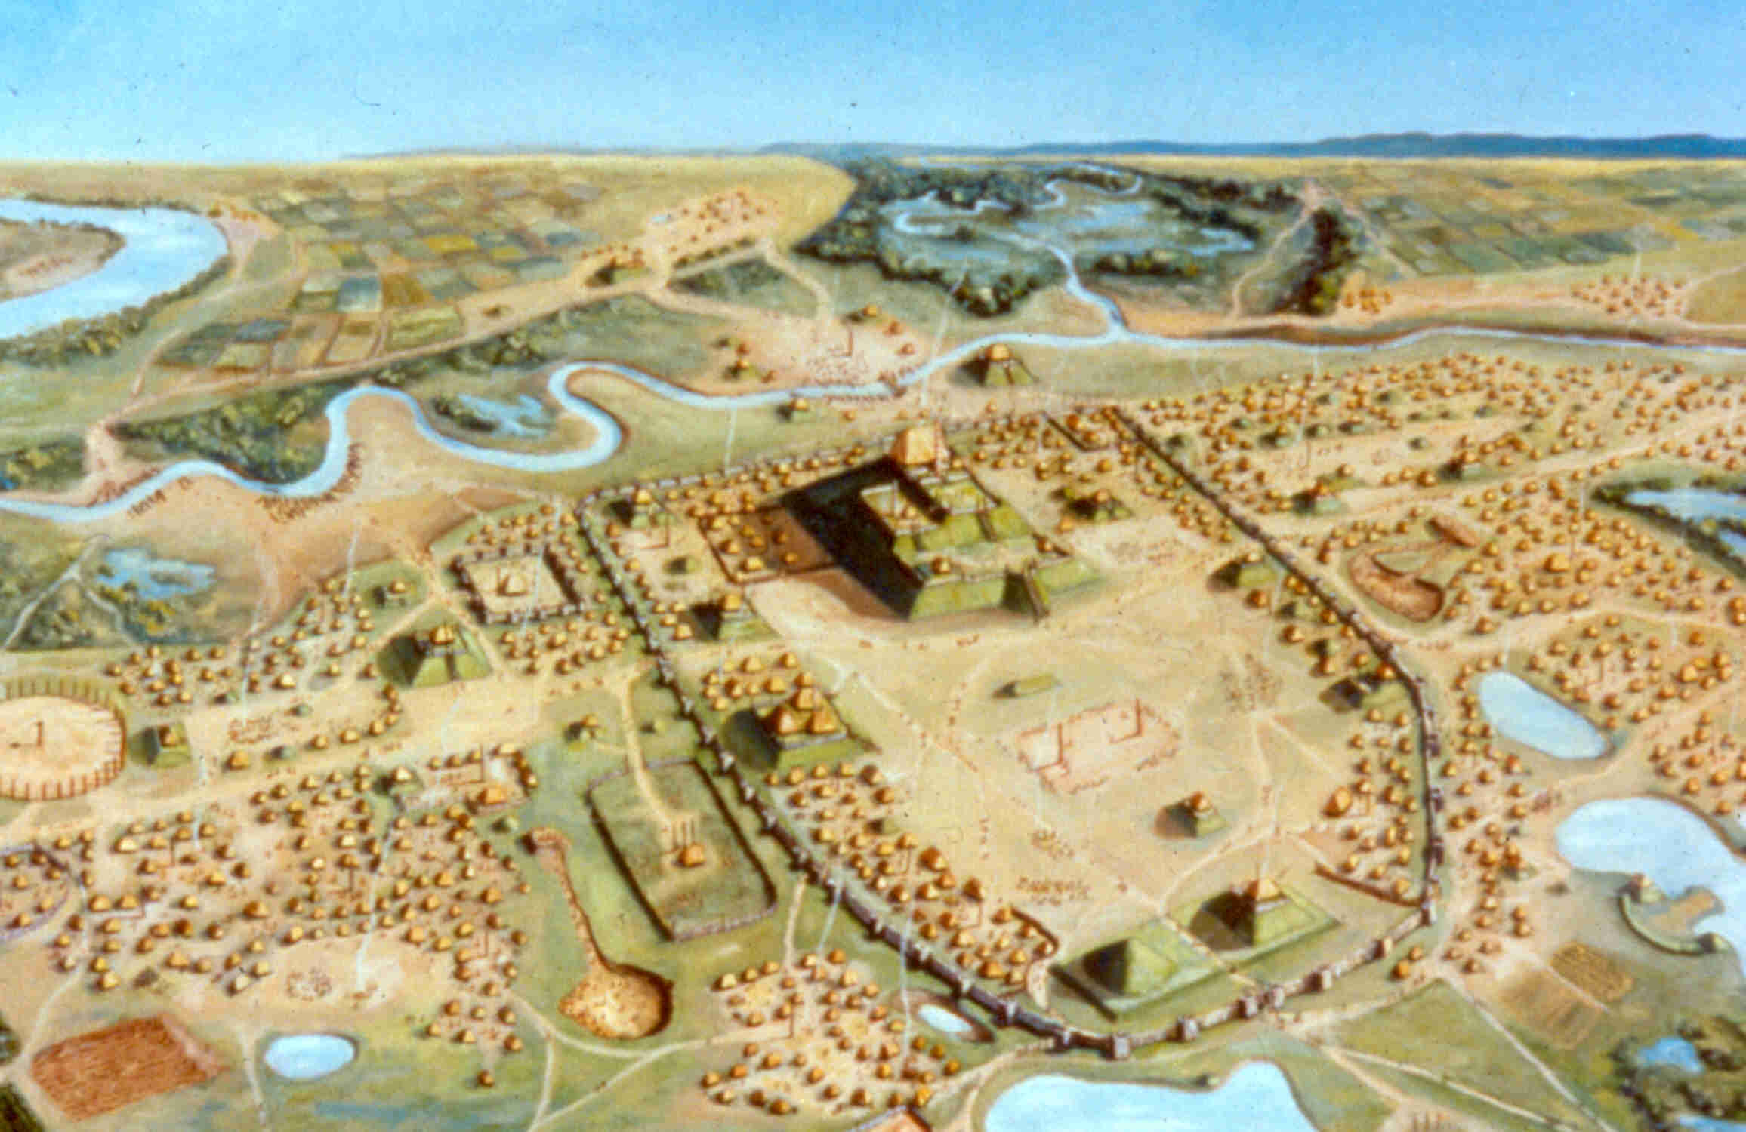
Cahokia!
Video

Slide 4
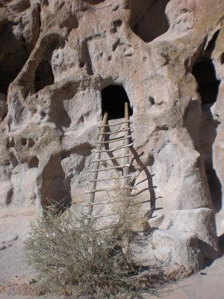
North America on the Eve of Colonization: The Southwest
Yumans
Spread-out, irrigated desert farms
Pueblos
Committed to communal living
Apaches
Hunters and gatherers
Traded with or raided farming communities

Slide 5
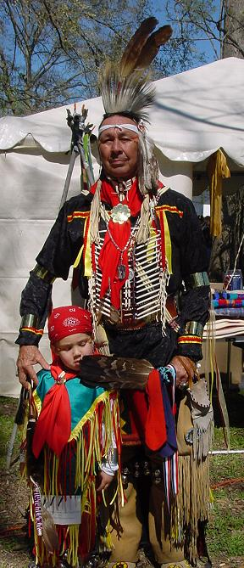
The South
Natchez
Agricultural societies
Confederacies of towns
Class-based societies with a ruler,
nobles, etc.
Warfare common
Choctaws, Chickasaws, Cherokee
Looser, non class-based
Matrilineal societies

Slide 6
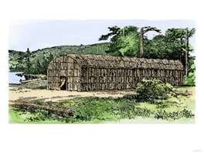
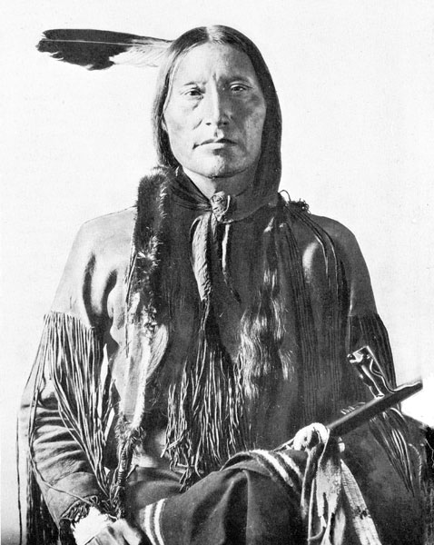
The Northeast
Iroquois
Farmers; corn key crop
Lived in longhouses occupied by large matrilineal extended families
Five separate Iroquois nations formed the Iroquois Confederacy to control violence
Algonquians
Smaller communities of hunter-gatherers

Slide 7
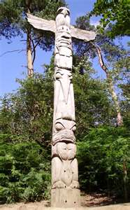
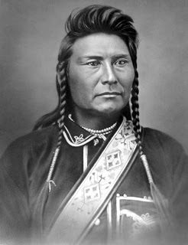
The Pacific Coast
Many different groups (e.g. Chinook, Tlingit)
Permanent settlements
Fish most important food source
Lumber used for practicality and
ceremony

Slide 8
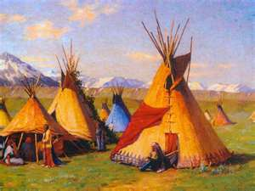
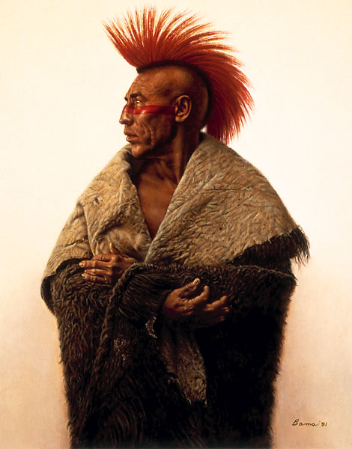
The Great Plains
Eastern Plains tribes (e.g. Iowa, Kansas, Pawnee) relied on farming
Western Plains tribes (e.g. Sioux) abandoned farming and became nomadic hunters
Lived in teepees
Horses had huge impact

