Slide 1
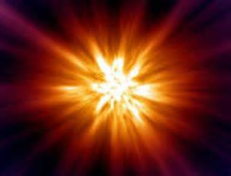
The Big Bang

Slide 2
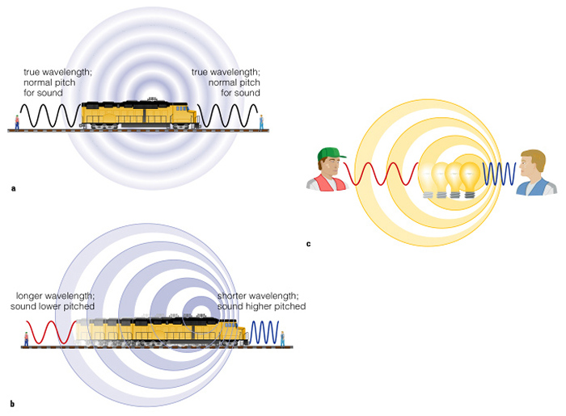
The Doppler Effect and Redshift

Slide 3
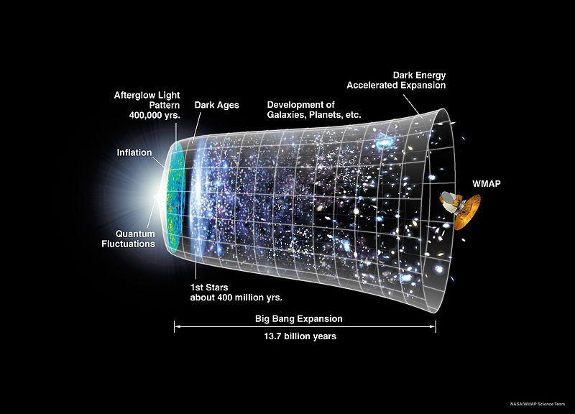
Cosmic Microwave Background

Slide 4
The Abundances of Elements
About 25% of the matter in the Universe is helium
Fusion in stars makes only enough for there to be 10% helium
Conclusion: helium had to have formed before galaxies and stars were born

Slide 5
Notes:
Analysis predicted 7 to 1 proton to neutron ratio, which would in fact produce the 25% helium composition we now observe.

