Slide 1
United States History Theme 1: Cultures in Contact

Slide 2
The United States Today
2010 Census Ethnic and Racial Background (p.4)
Notes:
Discuss: how do these groups get along with each other today?

Slide 3
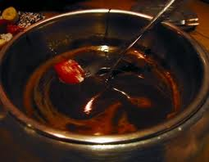
Which Image Is Most Accurate?

Slide 4
America Today: Equal Opportunity?
Income in Detroit
Disparity in St. Louis
Being Black in America
Conditions for Native Americans
Notes:
Detroit: Interactive income map
St. Louis: Listen starting at 2:05

Slide 5
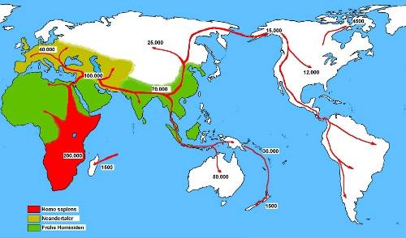
A Brief History of the World

Slide 6
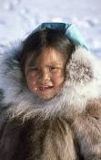
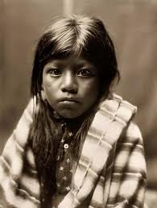
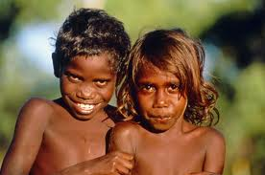
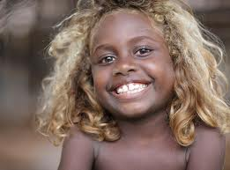
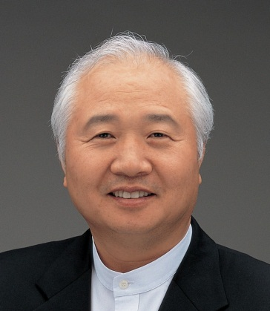
Faces From Around the World

Slide 7
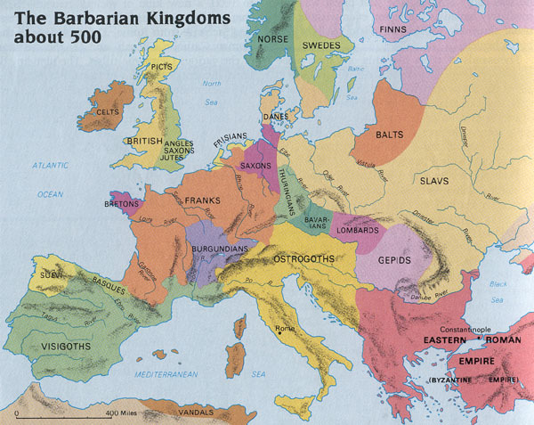
Tribes Develop…

Slide 8
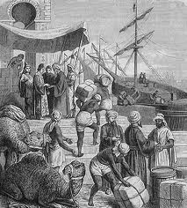
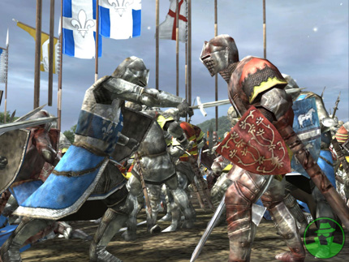
…and interact

Slide 9
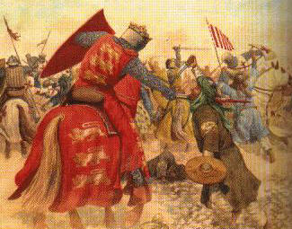
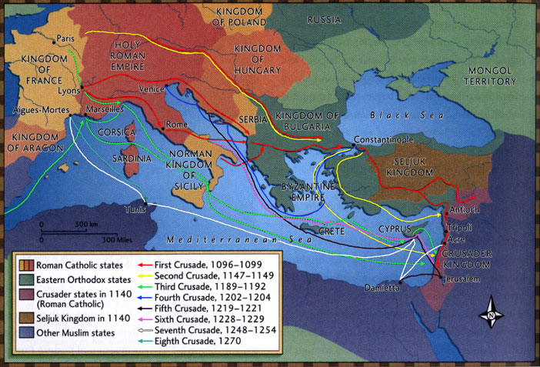
Improved Technology Leads to Improved Transportation and More Interaction
The Crusades

Slide 10
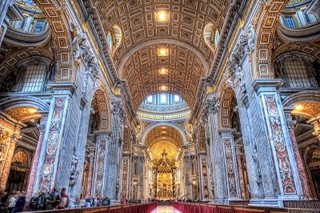
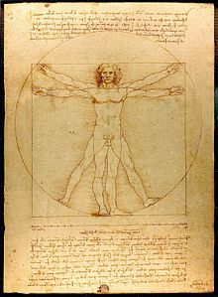
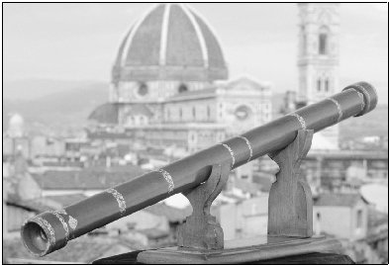
And More Interaction Leads to Improved Technology and Hunger for Knowledge…
Renaissance

Slide 11
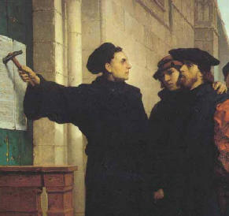
…which leads to challenging old beliefs…
Reformation

Slide 12
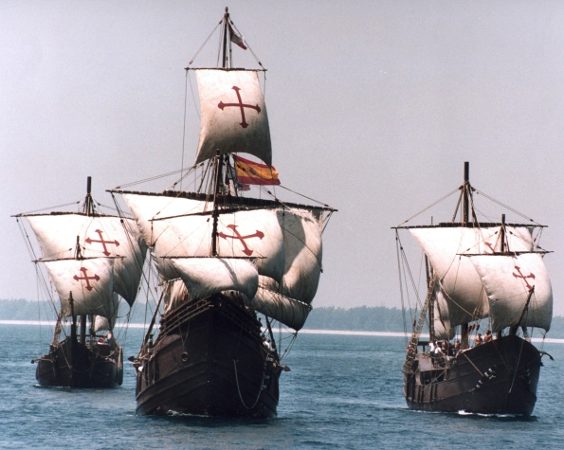
…and an increased desire and capability to explore
In 1492…

Slide 13
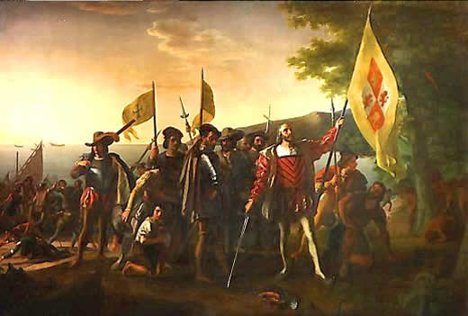
Europeans “discover” America…

Slide 14
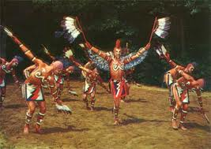
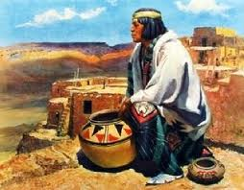
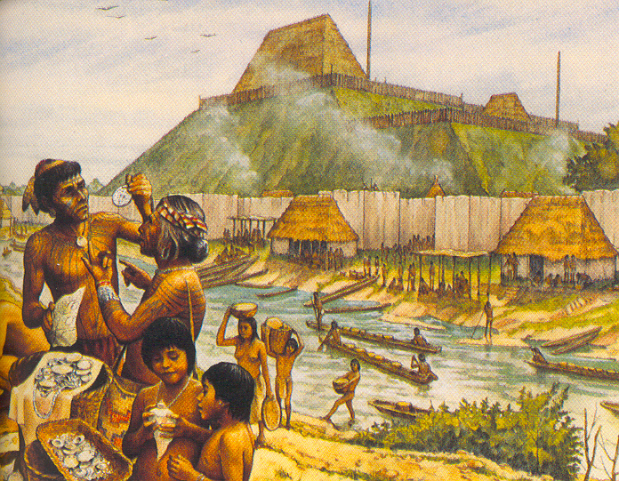
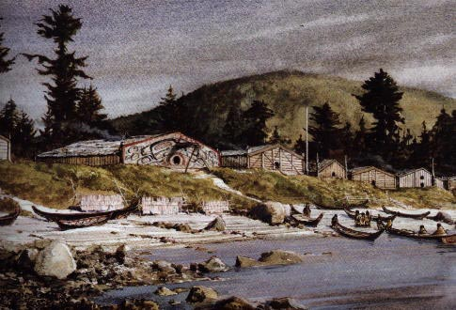
…but it was not an empty continent

Slide 15
Cultures in Contact Wrap

Slide 17
1920 Map

Slide 26
Walter Smith · Idaho Springs, Colorado:
“Muslims will not never live by the Constitution or have American Values. This army of imvaders is going to cause some serous damge if not stoped. No WaY, No Muslims.
Link
Notes:
Today at least we would never characterize people as enemies like they did the Catholics!

Slide 27
Notes:
Before this slide: We wouldn’t try to exclude anyone today! We’ve learned our lesson!

Slide 28
Notes:
Discuss how these immigrants have contributed to our country

Slide 29
The New Colossus
By Emma Lazarus 1849–1887
Not like the brazen giant of Greek fame,
With conquering limbs astride from land to land;
Here at our sea-washed, sunset gates shall stand
A mighty woman with a torch, whose flame
Is the imprisoned lightning, and her name
Mother of Exiles. From her beacon-hand
Glows world-wide welcome; her mild eyes command
The air-bridged harbor that twin cities frame.
“Keep, ancient lands, your storied pomp!” cries she
With silent lips. “Give me your tired, your poor,
Your huddled masses yearning to breathe free,
The wretched refuse of your teeming shore.
Send these, the homeless, tempest-tost to me,
I lift my lamp beside the golden door!”

Slide 30
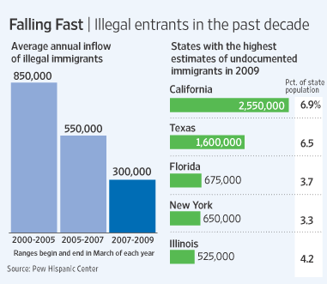
Immigrating to the U.S.
Who can come legally?
The roadmap to immigration
Notes:
Note: from 2007-2009, more undocumented people left than came in; there have been some recent spikes, most of which have come from places other than Mexico

Slide 31
Immigrating to the U.S. Without Documentation
Vid Clip (start at 12:00)

