Slide 1
Cultures in Contact: Europeans and Native Americans

Slide 2
Trivia
What country did Christopher Columbus sail for?
Where did he land?
Where did he think he was?
Was he a good guy?

Slide 3
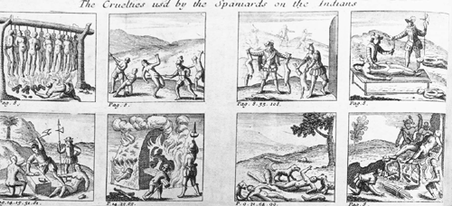
Spanish Treatment of the Natives

Slide 4
Exploration and Colonization Expands
Spain builds a large and profitable American empire
Portugal, France, Netherlands, and England join competition for territory before the end of the 1500’s
Study map on pp. 12-13: the Columbian Exchange

Slide 5
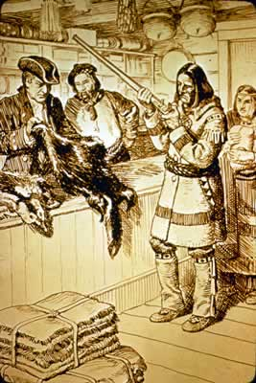
The French in America

Slide 6
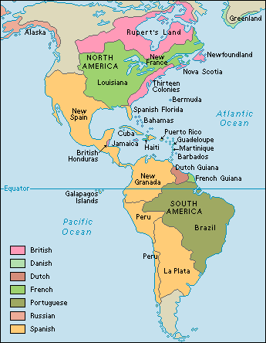
Europeans in America

Slide 7
England in the Chesapeake Bay
Jamestown, Virginia the site of the first permanent British settlement
First settlers in Jamestown saved by Powhatan Confederacy
A confederacy of Algonquian tribes led by Powhatan
1609: Settlers start to raid native villages for food and supplies
Powhatan realizes the British came “not for trade, but to invade my people and possess my country.”
Cuts off trade with the settlers

Slide 8
Starving Time
Winter of 1609-1610
By spring 60 of 900 settlers still alive
“Having fed upon horses and other beasts as long as they lasted, we were glad to make shift with vermin, as dogs, cats, rats, and mice…Nothing was spared to maintain life and to do those things which seem incredible, as to dig up corpses out of the graves and to eat them.” -George Percy

Slide 9
The European Presence Expands
As European nations expand in the Americas, Native American tribes fight for land and a way of life
Most native nations form alliances with European nations

Slide 10
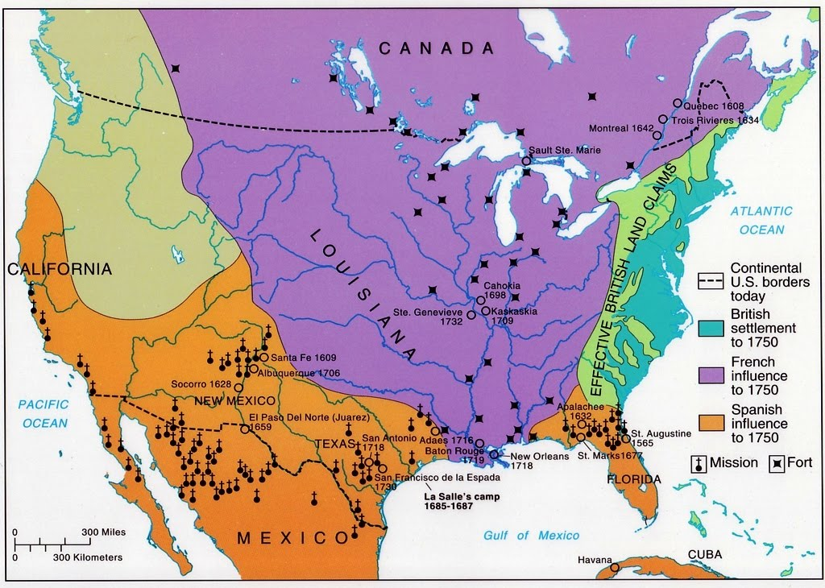
The French and Indian War
The British and the French fight for control of North America

Slide 11
The French and Indian War
Many tribes allied with France
British form alliance with powerful Iroquois Confederacy
Promise a clear boundary for British settlement
France dominates early fighting
France’s native allies raid British settlements, killing thousands
British turn the tide and win in 1760
England establishes the Proclamation Line of 1763, limiting colonization to land east of the Appalachians and reserving the rest for Native Americans

Slide 12
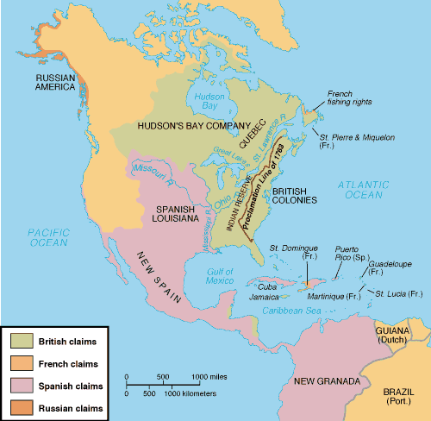

Slide 13
Put Yourself in Their Shoes
How do you think Western farmers felt about the Proclamation Line?
Who do you think Native American tribes were inclined to ally themselves with in the Revolutionary War?

Slide 14
The New United States and Native American Nations
White settlers rapidly expand Westward after Independence
Various Native American nations fight back
U.S. victory at the Battle of Fallen Timbers leads to treaty giving much land in Michigan, Ohio, and Indiana to U.S.

