Slide 1
The Development of Civilizations
From Bands of Hunter-Gatherers to Empires

Slide 2
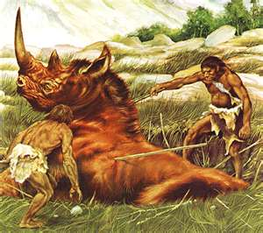
Hunter-Gatherers
All humans were hunter-gatherers until 10,000 years ago

Slide 3
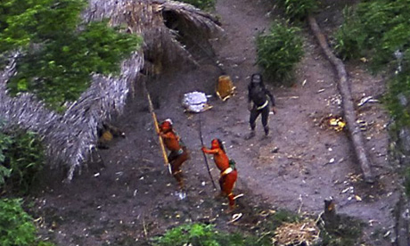
Hunter-Gatherers
And some still are!

Slide 4
The Growth of Agriculture
Study the map on p. 14
Explore the “History Close-Up” on p. 16

Slide 5
Farming
Cities
Art and Architecture
Organized government
Record Keeping and Writing
Specialization of Labor
Formalized Religion
Social Classes

