Slide 1
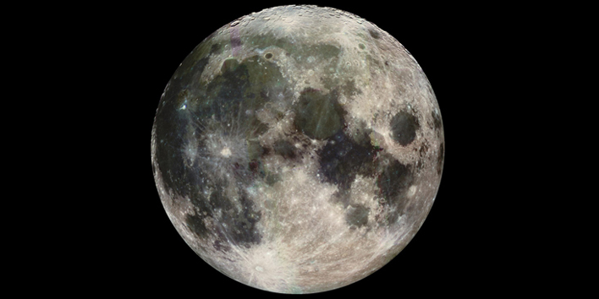
The Moon

Slide 2
Why are there so many craters on the moon?

Slide 3
How else does the lack of an atmosphere affect the moon’s surface?

Slide 4
What is the interior of the moon like? How do we know?

Slide 5
How do many scientists think the moon was formed?

Slide 6
28.2 Movements of the Moon

Slide 7
The Dark Side of the Moon
Discussion: What is the “Dark Side of the Moon?” Is it really always dark?
The moon takes the same amount of time to rotate as it does to revolve around the Earth (27.3 days), so one side is always facing away from Earth. It is not always dark.
Challenge: revolve around your desk so that you complete one rotation during one revolution
Notes:
Demo: Student revolves around another student, always facing him/her

Slide 8
Moonrise and Moonset
Vote: Does the moon rise and set at the same time each night?
No! It rises and sets 50 minutes later each day!
Time table
Demo
Notes:
Demo: a student rotates (Earth) while I (moon) partially revolve around him, showing how the moon won’t come into view until later.

Slide 9
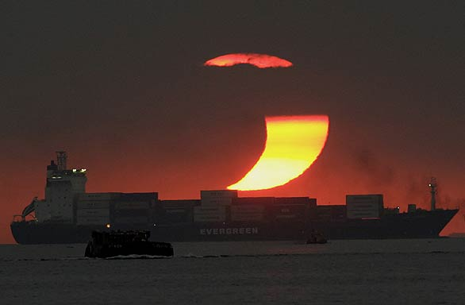
Solar Eclipse
Notes:
Ask: What is a solar eclipse?

Slide 10
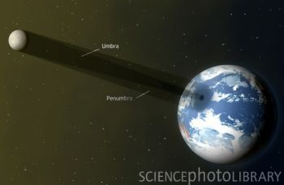

Slide 11
Solar Eclipse
When the Earth passes through the moon’s shadow
The moon is between the sun and part of the Earth
Total solar eclipses take place about once every 18 months somewhere on Earth
At any point on Earth, eclipses are very rare
One will come here in 2106!
Annular eclipse 2048
Eclipse maps
Notes:
Teach about annular eclipse by having place thumb between eye and object, then moving thumb closer until just a little of the object is visible (annular) and then none if it is visible (total)

Slide 12
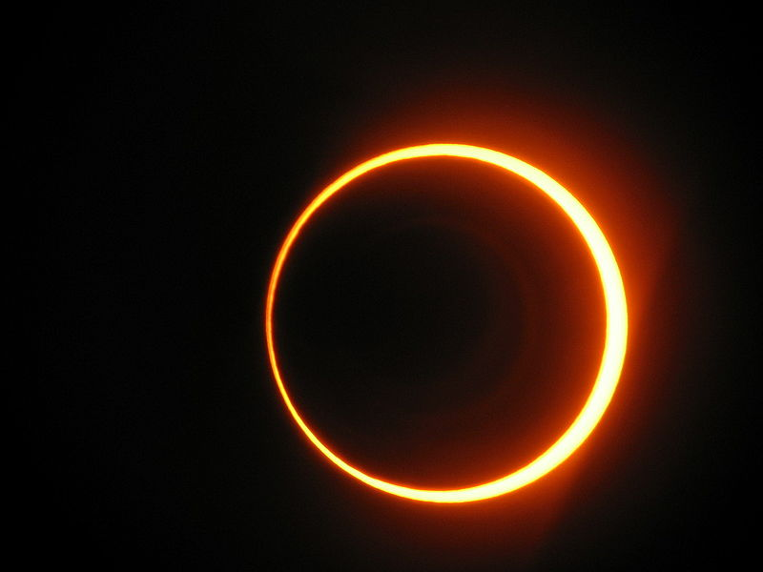

Slide 13
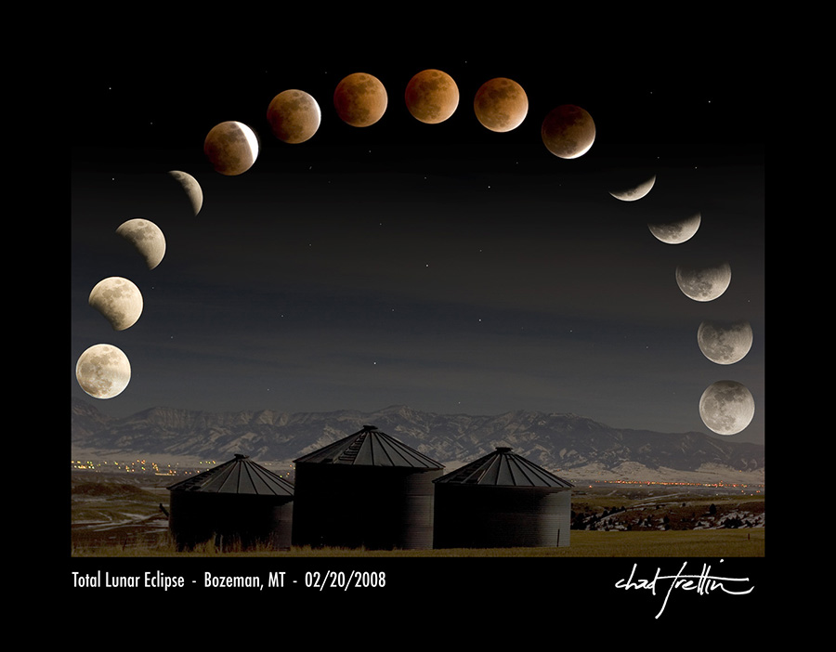
Lunar Eclipse
The moon passes through the Earth’s shadow
The Earth is between the sun and the moon
Happens at same frequency as solar eclipses
Can be seen by entire dark side of Earth

Slide 14
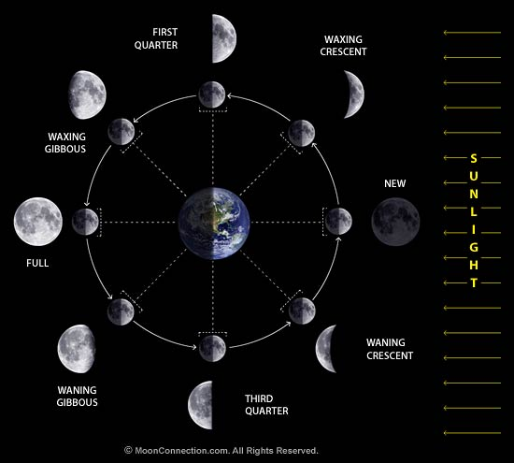
Notes:
Demo: students rotate in darkened room with lamp to see shape of lit side

