Slide 1
The Origins of Man

Slide 2
Unit Essential Questions
How did people populate the Earth? How and when did different people groups emerge?
How do historians and scientists formulate their theories about how the earliest people lived?

Slide 3
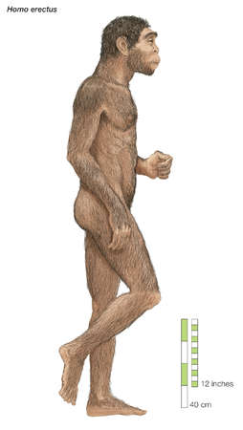
Hominids (human-like beings that walked upright)
Homo Erectus
“Upright Man”
Originated in Africa and populated Europe and Asia
Used tools, controlled fire
Believed to have lived 1.7 million to 500,000 years ago
Ancestor of modern humans or separate species that went extinct?

Slide 4
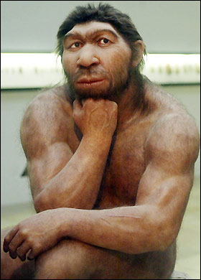
Hominids cont.
Neanderthals
Lived 200,000 - 30,000 years ago in Eurasia
Ancestor of modern humans or separate species that went extinct?
One theory is that they lost competition with modern humans

Slide 5
Hominids Cont.
Homo Sapiens
Modern Humans
Appeared in Africa around 200,000 years ago
Made it to every continent by about 30,000 years ago

Slide 6
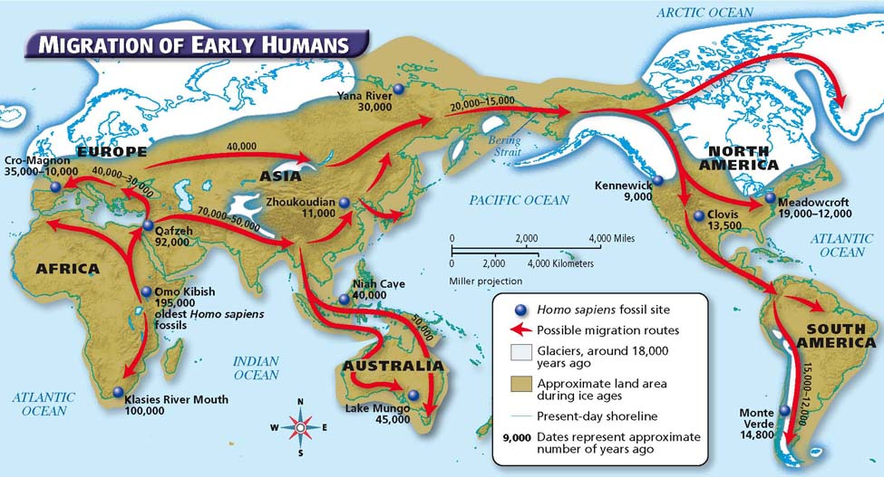
The Migration of Homo Sapiens

Slide 7
Religion and Science
What’s the truth?
Are the two necessarily at odds?

