Slide 1
Quiz Time!
What are we made of?
Where does that stuff come from?
How big is the Universe?
How old is the Universe?
How did it begin?
How many stars are there?

Slide 2
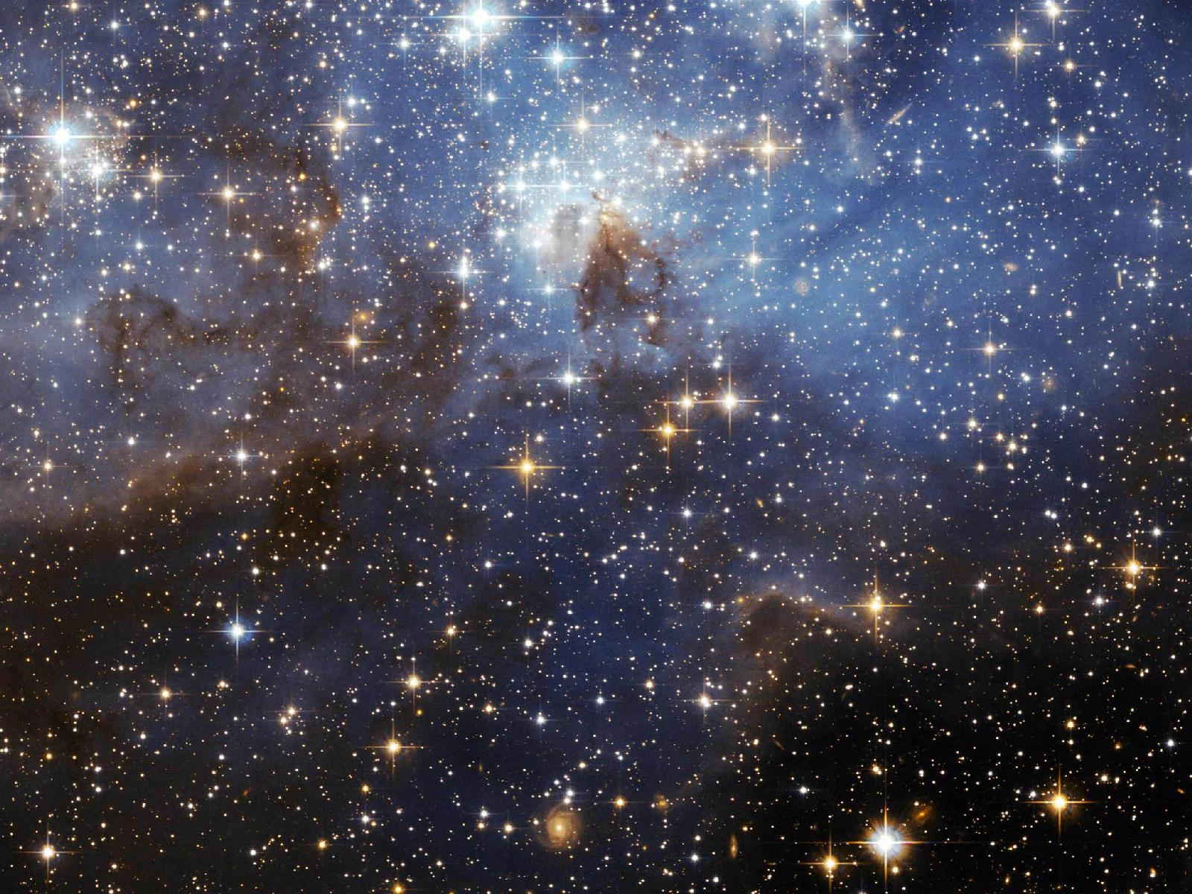
Space
Scientific Principles You Need To Know

Slide 3
Matter
Matter: Anything that has mass and occupies space

Slide 4
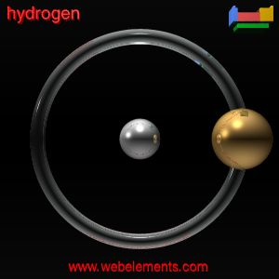
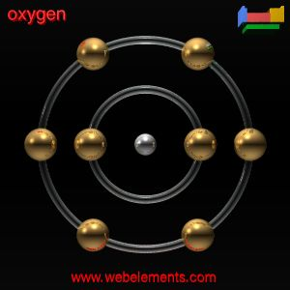
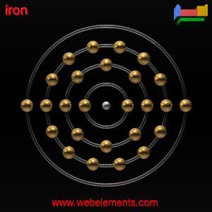
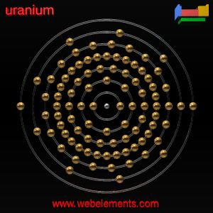
Atoms: The Building Blocks of Matter
The smallest part of an element that has the characteristics of that element.
a. There is a different atom for each element.

Slide 5
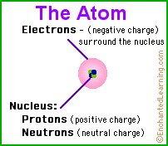
B. Atomic Structure
All atoms are composed of smaller parts called subatomic particles.
The Nucleus
a. Composed of protons and neutrons
b. Contains most of the mass of the atom.
c. Has a + charge
d. One Trillionth the volume of the atom.

Slide 6
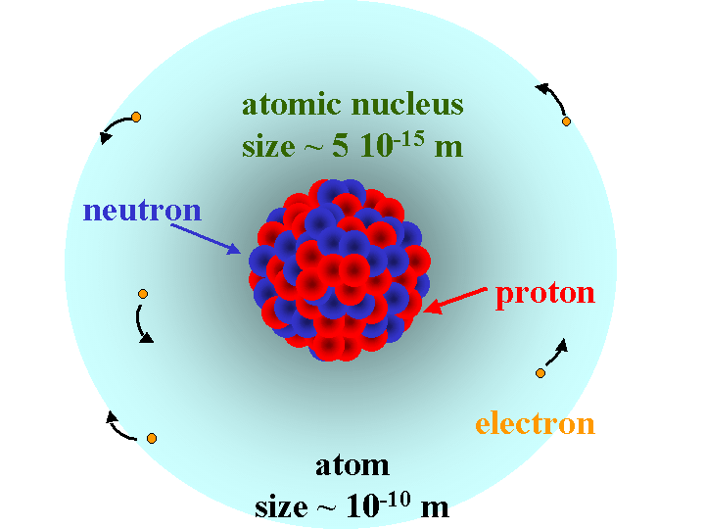
Nucleus

Slide 7
2. The Electron Cloud
Location in space around the nucleus where the electrons are located.
The size of the electron cloud is based upon the size of the atom and the number of electrons it contains.

Slide 8
C. Atomic Number

Slide 9
Atomic Number

Slide 10
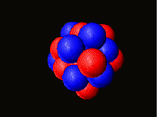
D. Atomic Mass
Sum of all the protons and neutrons in an atom
Electrons are not included, 1840 electrons = 1 proton in mass.

Slide 11
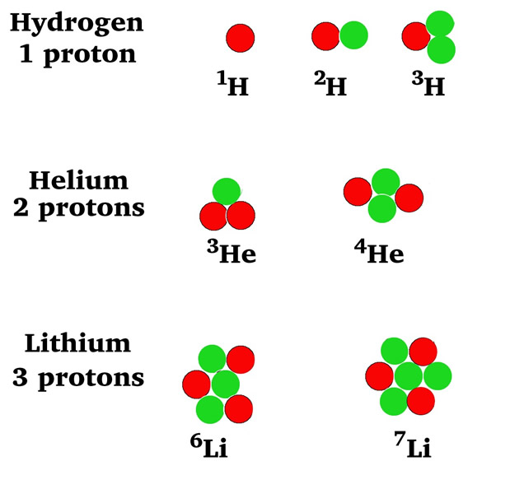
Isotopes

Slide 12
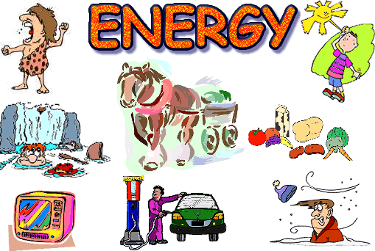
Energy
Energy: Causes something to move

Slide 13
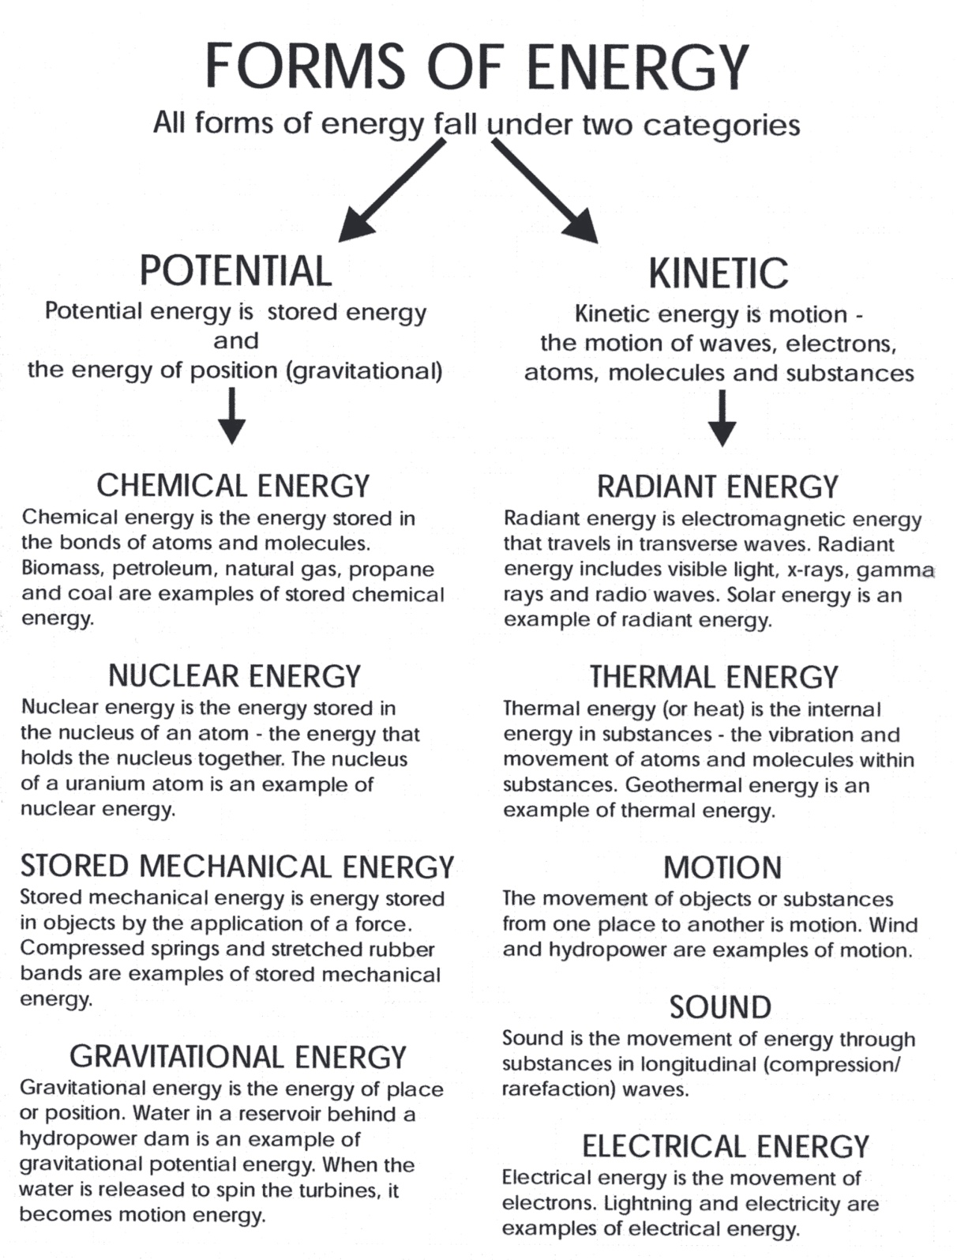

Slide 14
The Big Idea
Energy is neither created nor destroyed
Matter is neither created nor destroyed

Slide 15
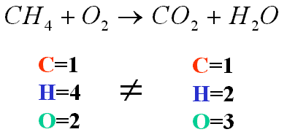
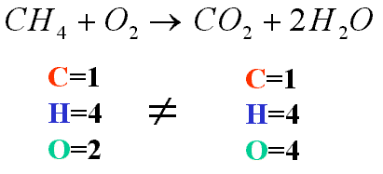
Balancing Chemical Equations

Slide 16
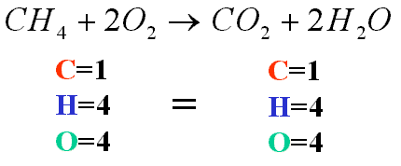
Balancing Equations

