Slide 1
Stars

Slide 2
Distance to Stars
Proxima Centauri: nearest star to Earth
4.2 light years away
Polaris 700 light years away
Notes:
Link: go to slide 18

Slide 3
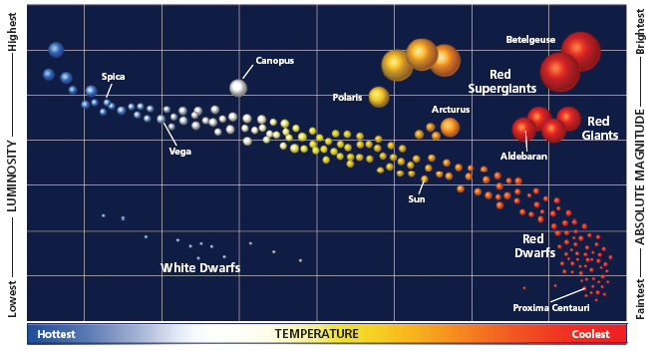
The Life Cycle of Stars
Stars last billions of years; no way to observe entire life cycle
Astronomers study stars at different stages of development to make model of star cycle

Slide 4
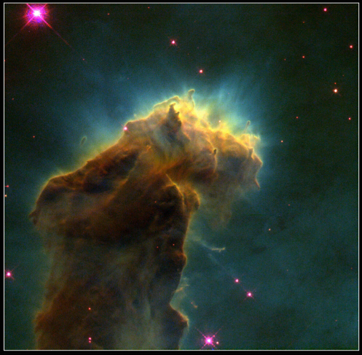
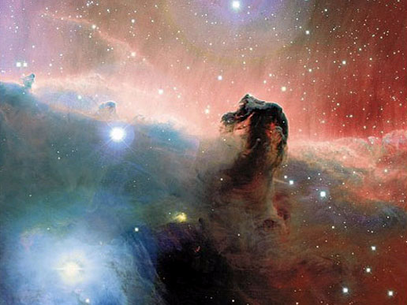
Star Formation
Star begins as a nebula
Cloud of dust and gas

Slide 5
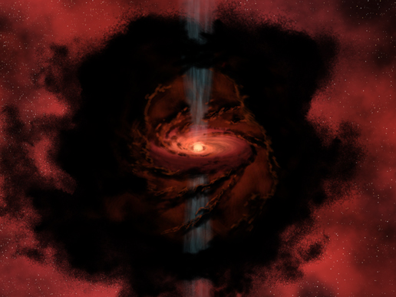
Protostar
A central concentration of matter within spinning disk
Artist’s rendition; nasa.gov

Slide 6
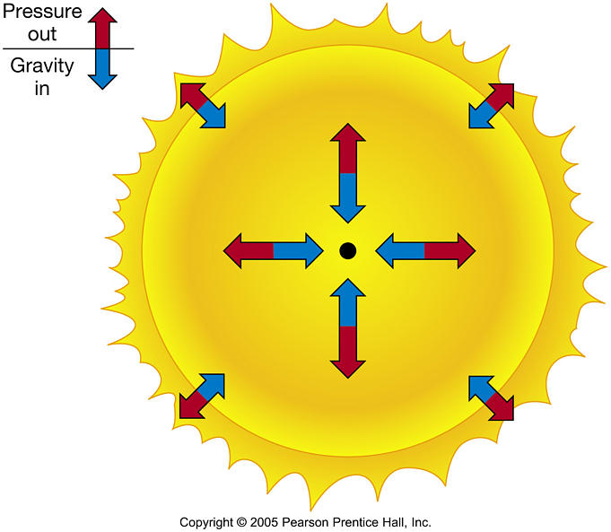
The Birth of a Star
A star is born when temperatures get hot enough to begin nuclear fusion
Fusion brings a stage of stellar equilibrium

Slide 7
The Main-Sequence Stage
When in stellar equilibrium, a star is in its main-sequence stage
The more massive a star is, the shorter its lifespan
The sun has an estimated lifespan of 10 billion years
Currently 5 billion years old

Slide 8
Leaving the Main Sequence
T-P-S: what will happen when fusion stops?
The core contracts
The contraction of the core increases the heat
The increase in heat causes fusion to continue in the outer shell
This outer-shell fusion causes it to expand greatly
Giants and supergiants are formed
How big are they?
Notes:
Ask: what will happen when fusion

Slide 9
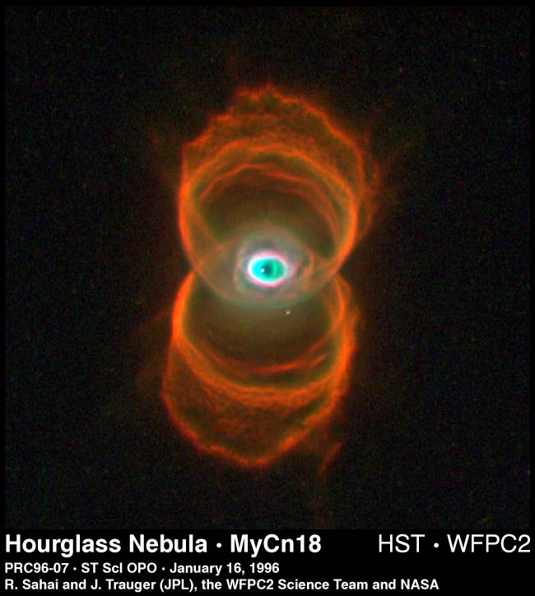
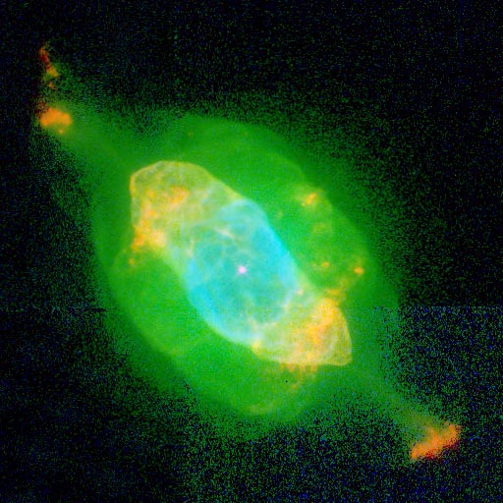
The Final Stages of a Sun-like Star
As outer gases drift away, they appear as planetary nebulas

Slide 10
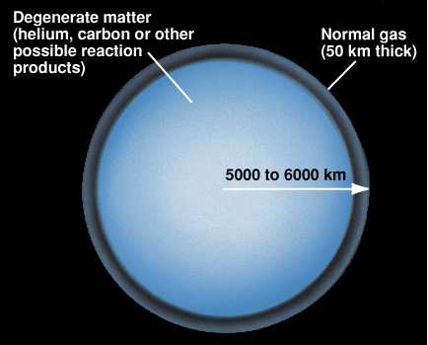
White Dwarfs
After the outer gasses drift away, a hot, extremely dense core of matter is left

Slide 11
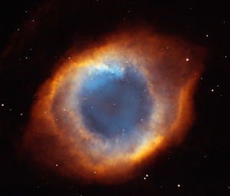
Novae
When a white dwarf captures gasses from a red giant explosions occur

Slide 12
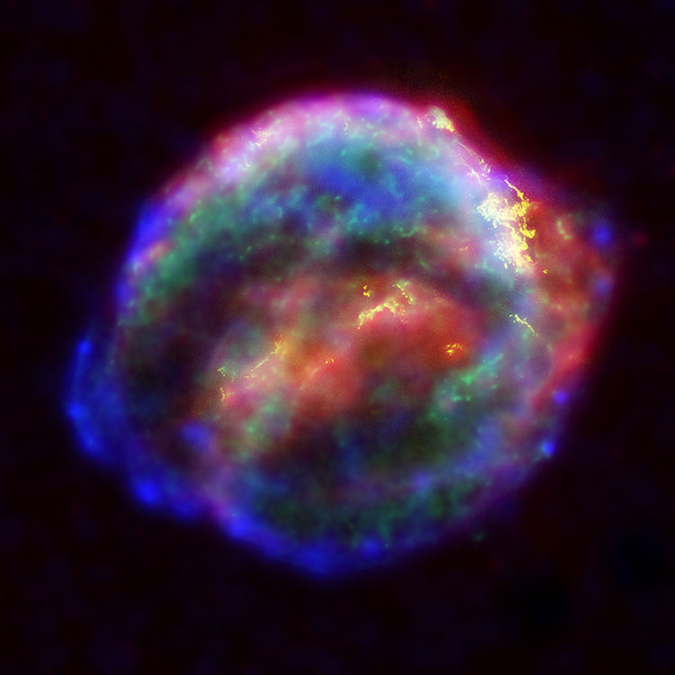
Supernovae
When the white dwarf explodes it is a supernova

Slide 13
Neutron Stars
A core may remain after a supernova to form a neutron star
Small but incredibly dense
A teaspoon of matter from a neutron star would weigh 100 million metric tons
May be 10 km in diameter but emit same energy as 100,000 suns

Slide 14
Life Cycle of Stars Summary
Vid
Notes:
Massive stars in ES playlist

Slide 15
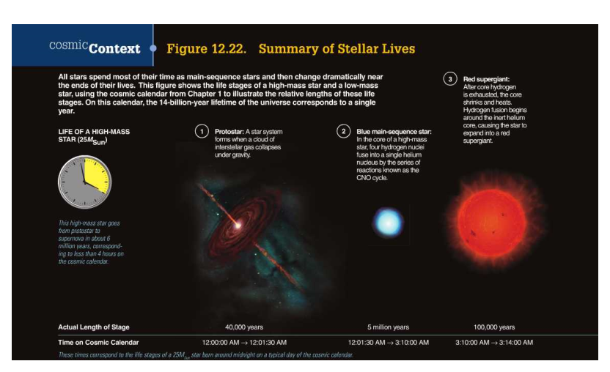
Life Cycle of Stars Summary

Slide 16
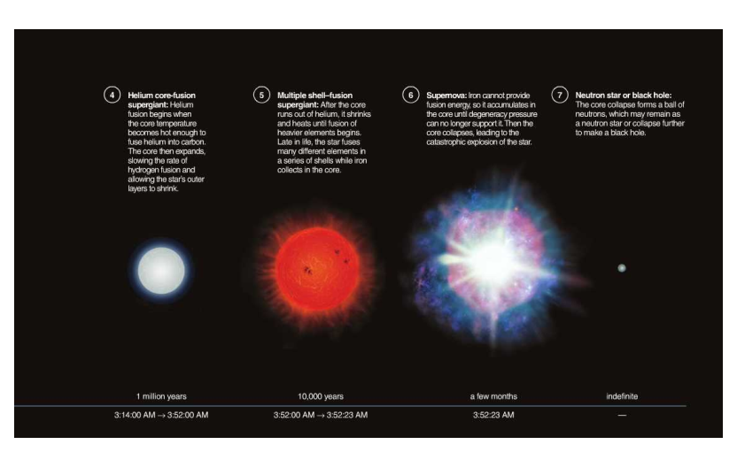
Life Cycle of High-Mass Star cont.

Slide 17
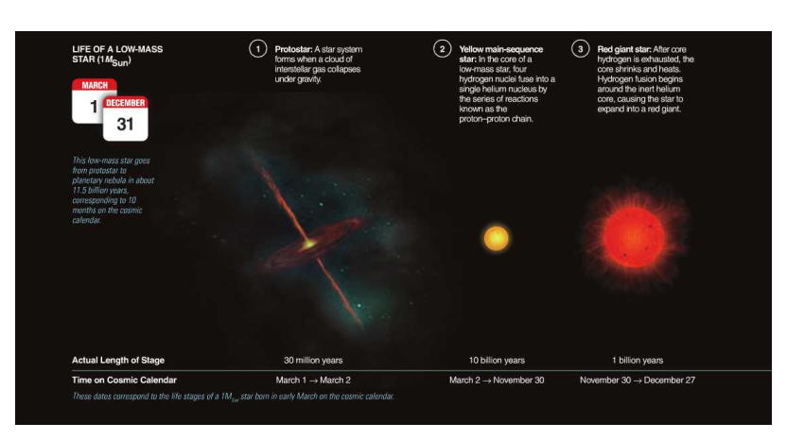
Life Cycle of a Low-Mass Star

Slide 18
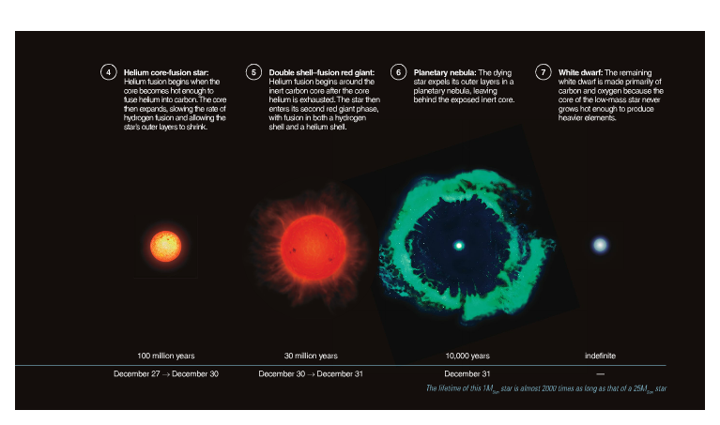
Life Cycle of a Low-Mass Star cont.

Slide 19
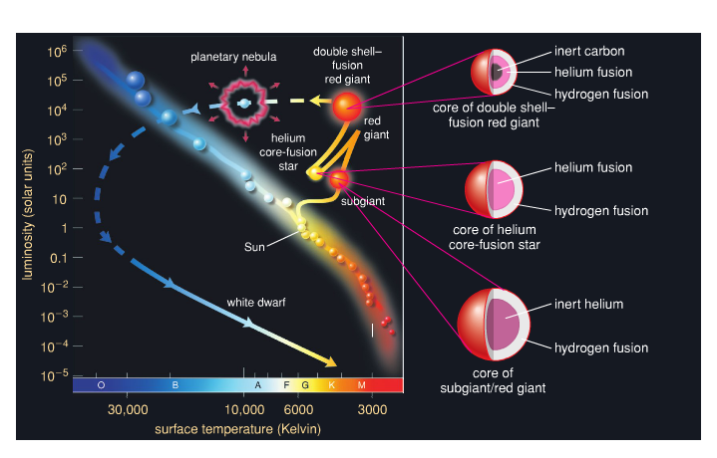
The Sun’s Life on the H-R Diagram

Slide 20
The Creation of Elements
Why is the Sun so hot?
Fusion: Hydrogen to Helium
What elements are most prevalent in Earth’s crust?
O, Al, Fe, Ca, Na, K, Mg
What elements are most prevalent in the human body?
O, C, H, N, Ca, P, S, K, Cl, Na

Slide 21
The Creation of Elements
What does it take for nuclear fusion to occur?
A great deal of energy (often in the form of heat). Why?
Protons are positively charged and repulse each other
How do other elements besides helium form in low-mass stars?
During the red giant phase, newly created helium from the outer shell packs into the helium core, increasing its density and temperature
Helium then fuses to form carbon
Notes:
From p. 342 Mastering Astronomy

Slide 22
The Creation of Elements
Low-mass stars never get hot enough for carbon fusion
High-mass stars create the heavier elements
When carbon fusion stops, the core condenses and heats until another type of fusion can take place, etc.
Iron is the end of the road
Notes:
From p. 349 in Mastering Astronomy

Slide 23
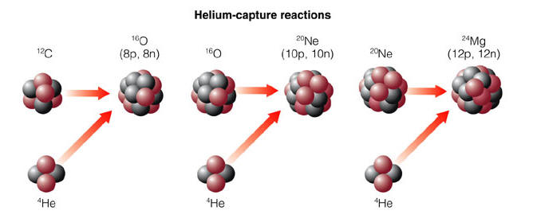
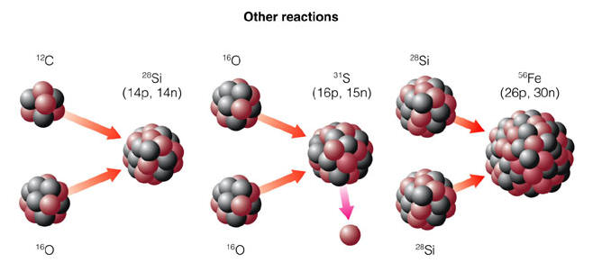
Nucleosynthesis
Notes:
Just examples; many others;

Slide 24
So What Does This Mean?
What elements are most prevalent in the human body?
O, C, H, N, Ca, P, S, K, Cl, Na
Where did these elements come from?
Were formed during the decay of high-mass stars and sent hurtling through space in Supernova explosions!
We are star stuff!

Slide 25
Galaxies

Slide 26
Scale of Galaxies
http://www.khanacademy.org/science/cosmology-and-astronomy/v/intergalactic-scale

Slide 27
How Did Galaxies Form?
In the early universe, matter was not evenly distributed
In areas of higher density, gravity caused matter to condense and form galaxies
Differing levels of density and centripetal force caused different types of galaxies to form

Slide 28
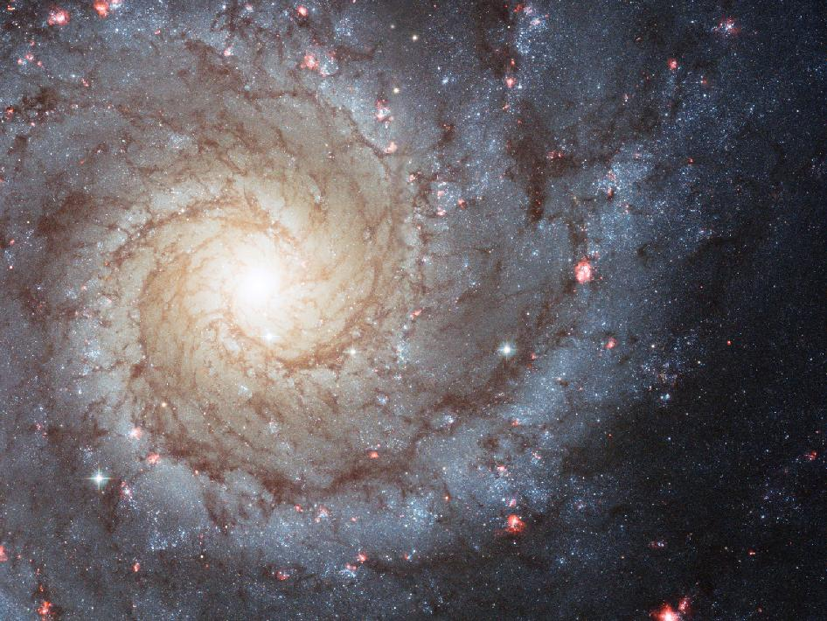
Spiral Galaxy
Notes:
Hubble photo; 32 million ly away

Slide 29
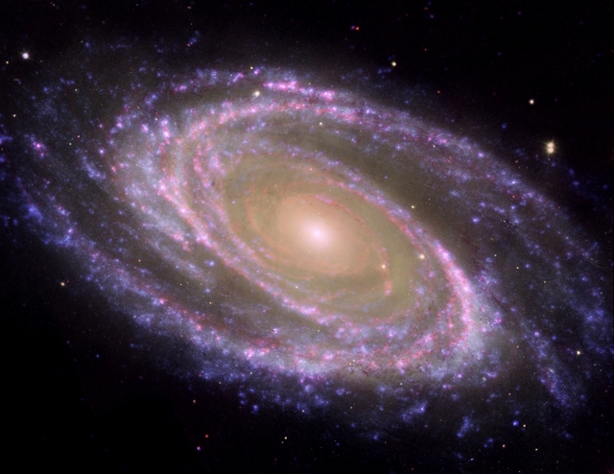

Slide 30
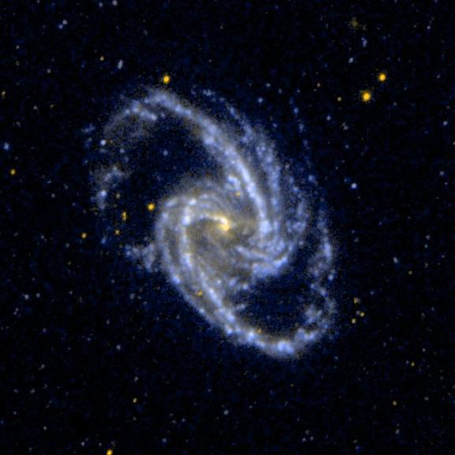

Slide 31
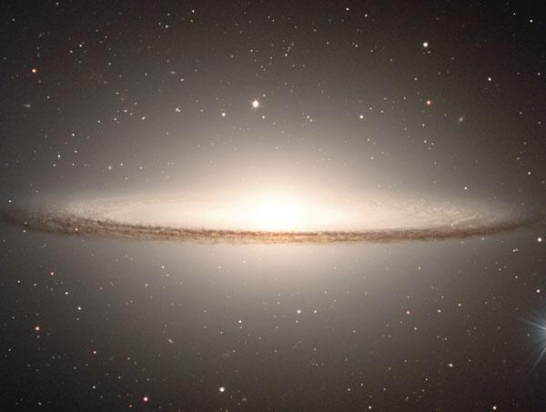

Slide 32
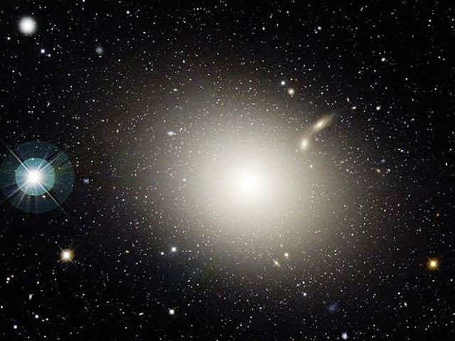
Elliptical Galaxy

Slide 33
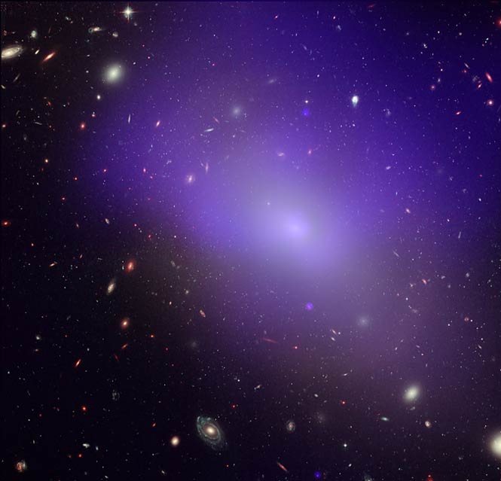

Slide 35
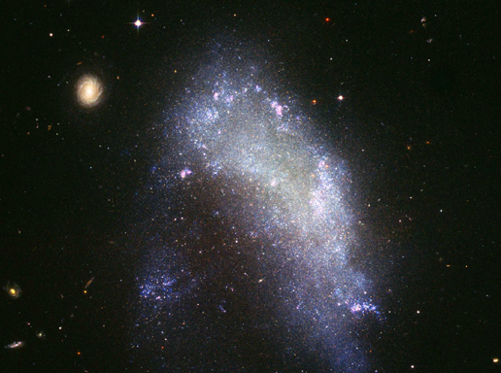
Irregular Galaxy

Slide 36
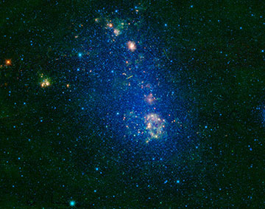

Slide 37
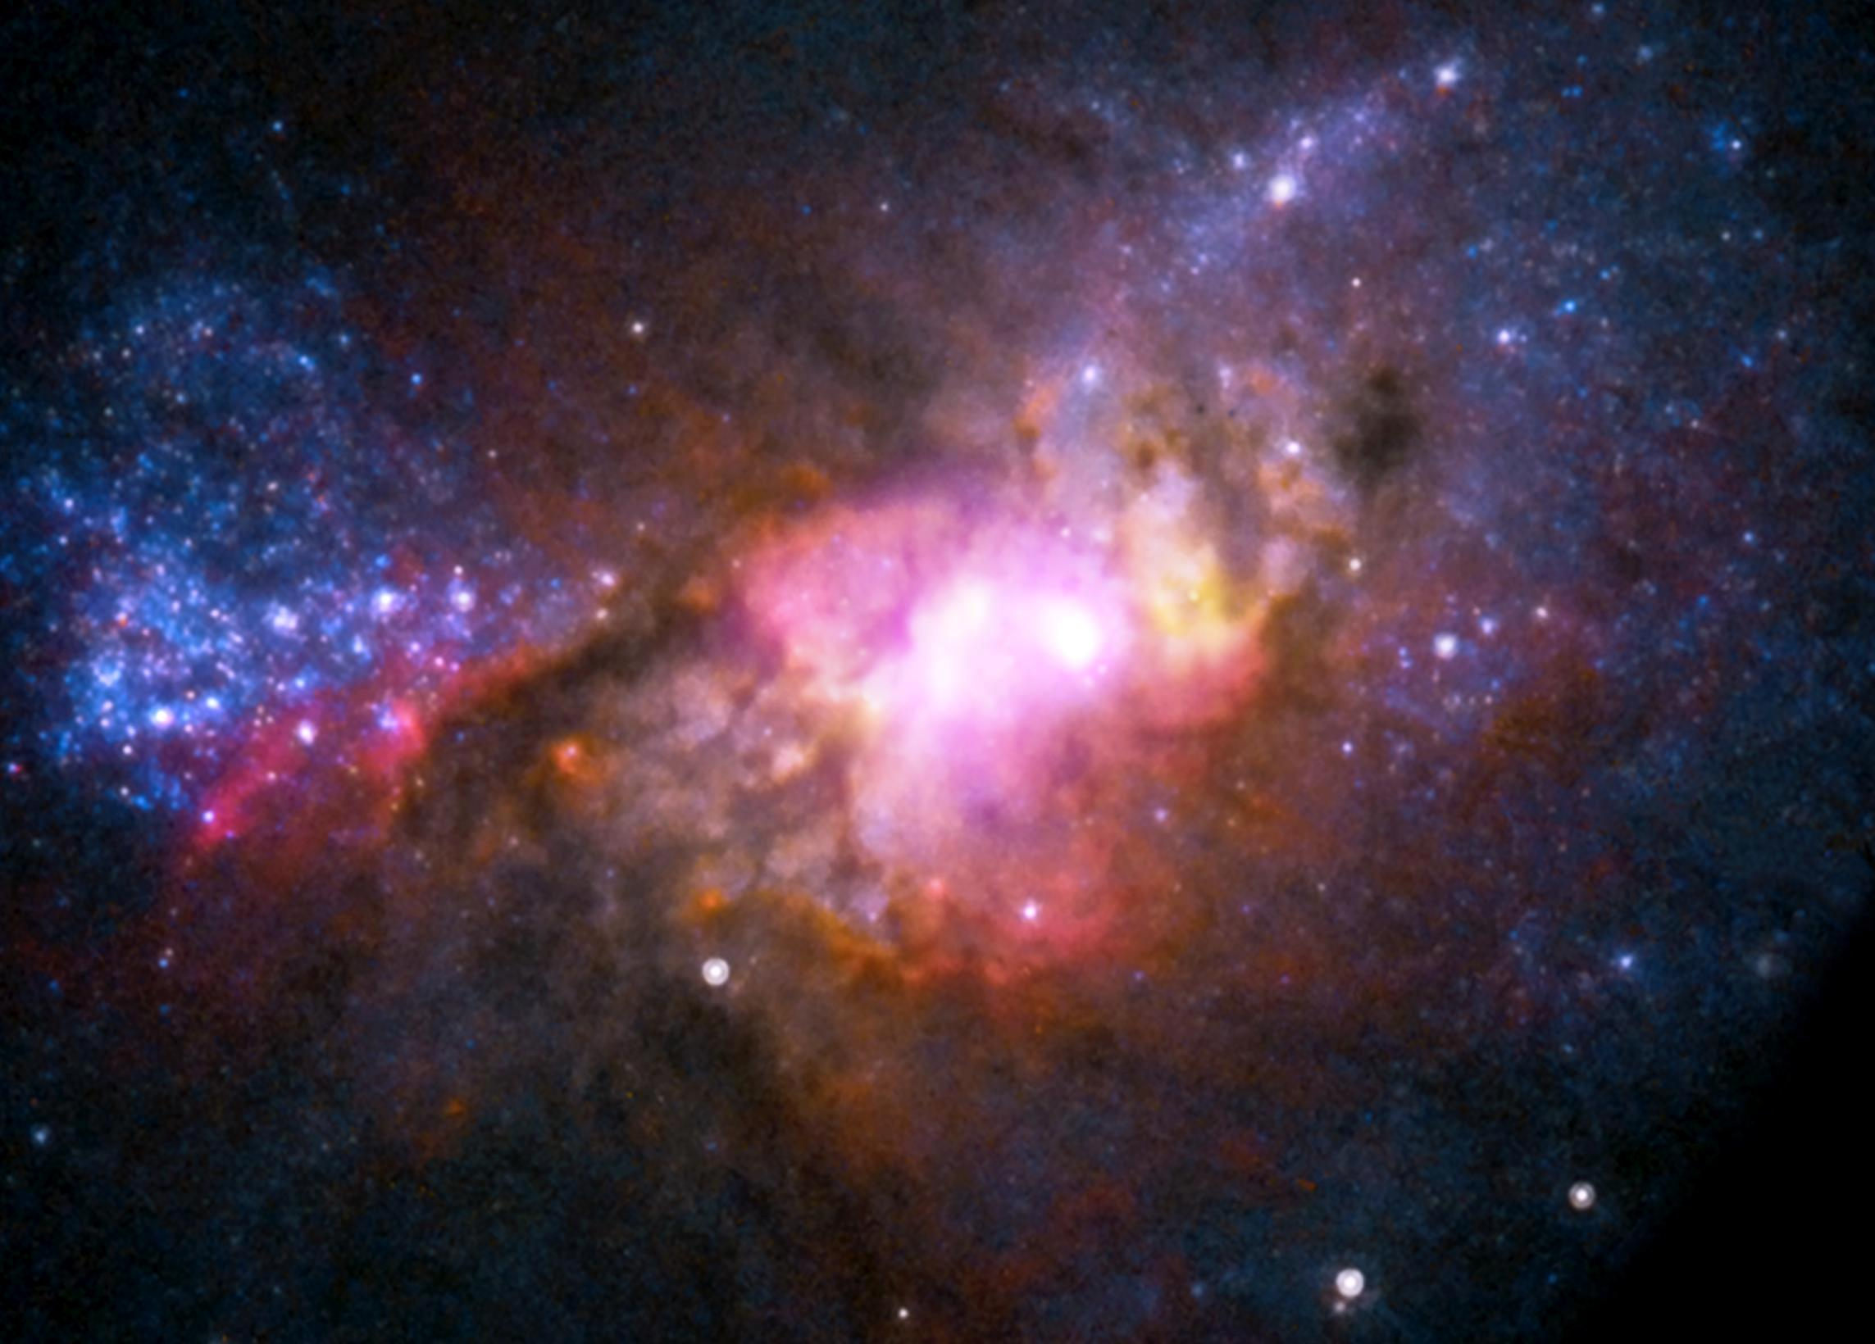

Slide 38
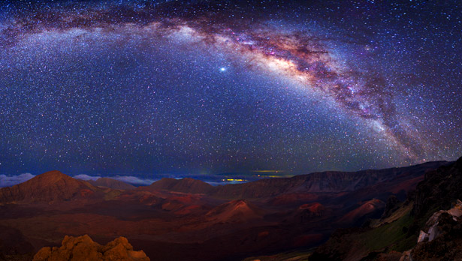
The Milky Way
Our solar system is in the Milky Way galaxy
Our sun is one of about 200,000,000,000 stars in the milky way
Notes:
Watch videos in ES playlist

Slide 39
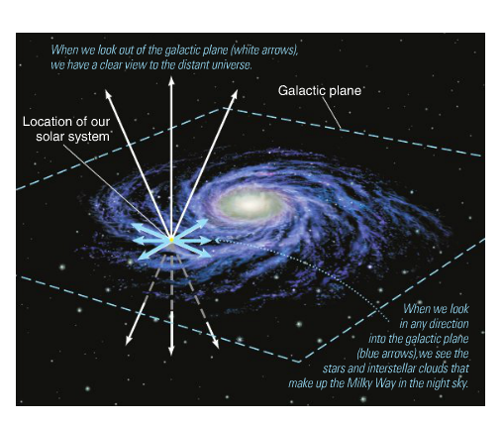
Notes:
Picture a link to vid

Slide 40
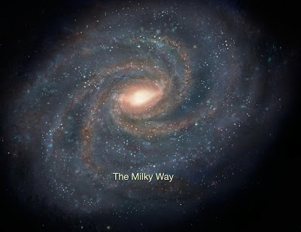
Notes:
Picture a link to interactive

