Slide 1
Westward Expansion and the American Indian

Slide 2
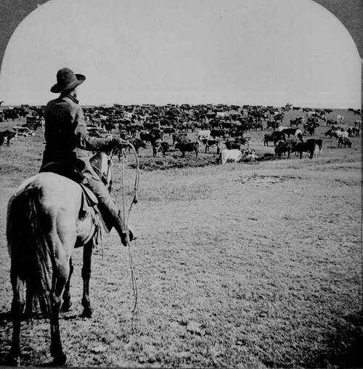
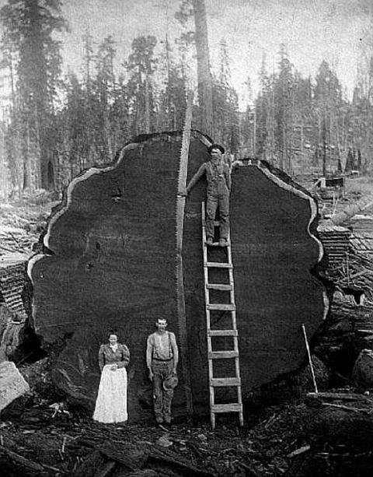
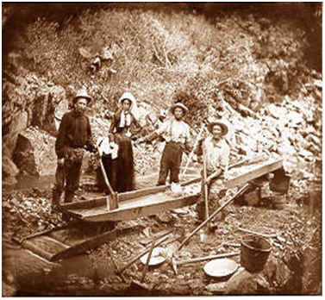
Why Did Anglo-Americans Go West?

Slide 3
Anglo-American Westward Expansion Generalities
Force Native Americans onto ever-shrinking reservations
Map in Motion
Why ever-shrinking?
What would it be like to be on a reservation?
Notes:
Point out that while we think of this as a horrible thing today, many at the time thought we were being too soft on them

Slide 4
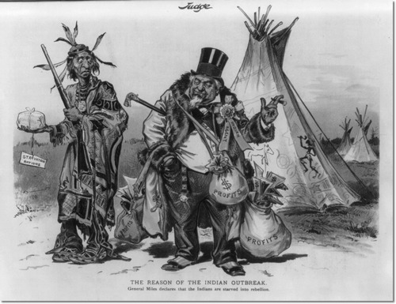

Slide 5
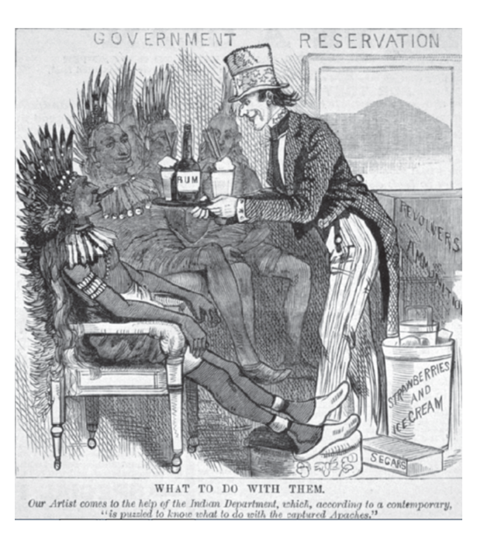

Slide 6
Violence as Some Resist
Sand Creek Massacre
November 1864: hundreds of native men, women, children killed while waiting to negotiate a peace treaty
Battle of the Little Bighorn
June 1876: George Custer and 208 other soldiers killed in attack on Sioux
Wounded Knee
December 1890: 200 Lakota men, women, children killed after fleeing reservation and performing Ghost Dance
Notes:
Fetterman Massacre, Little Bighorn, and Wounded Knee clips in Native Americans playlist

Slide 7
Anglo-American Westward Expansion Generalities
The two choices that seemed available at the time: kill or assimilate
“Humanitarians” try to assimilate Native Americans to Anglo-American culture
How did they try to do it?
What assumption underlies this effort?
“Kill the Indian, save the man”
Carlisle Indian School Before and After

Slide 8
The AIM Takeover at Wounded Knee
1972: What else was going on around this time?
Video Excerpts!
What conditions did the takeover bring to light?
What were some of the long-term consequences?
Notes:
Excerpts in Native American safari playlist

Slide 9
Civil War
The success of the Radical Republicans
The suspension of habeas corpus
Still a debate today?
Analysis

